Slide 1
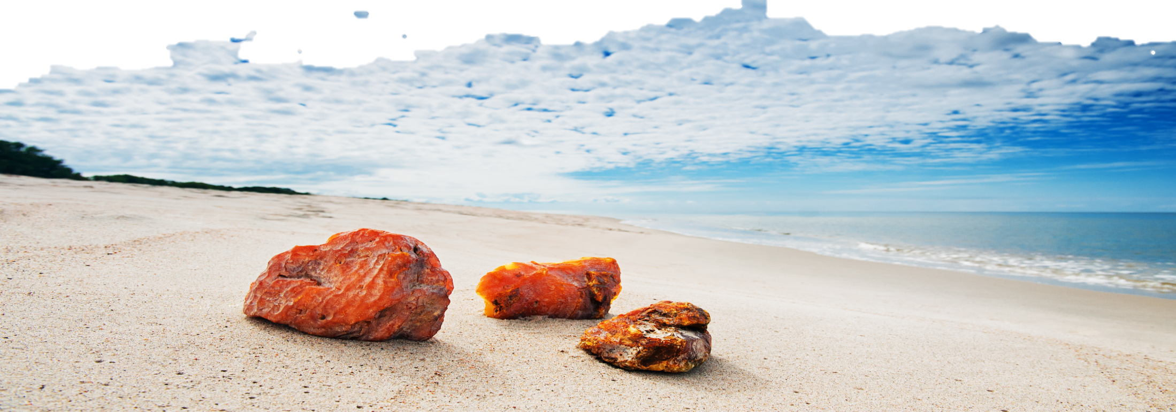
AMBER COMBINE AS A PART OF THE AMBER ROUTE
2012

Slide 2
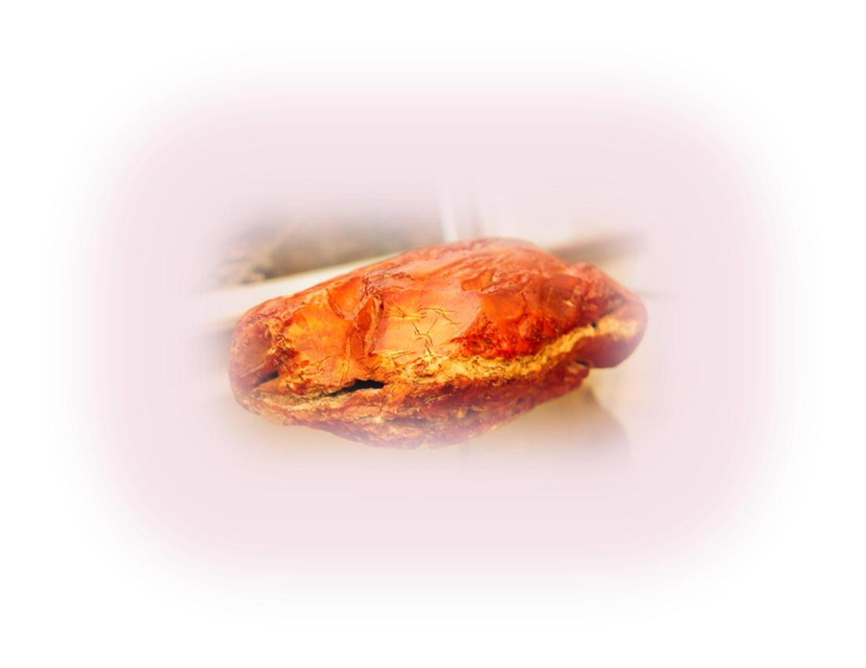
THE AMBER COMBINE
We invite you to visit the only place in the world, where the solar stone is commercially produced.
We present an amber vertical, which includes:
Amber mining
Processing of amber
Wholesale and retail sales of raw amber and finished products
Industrial tours

Slide 3
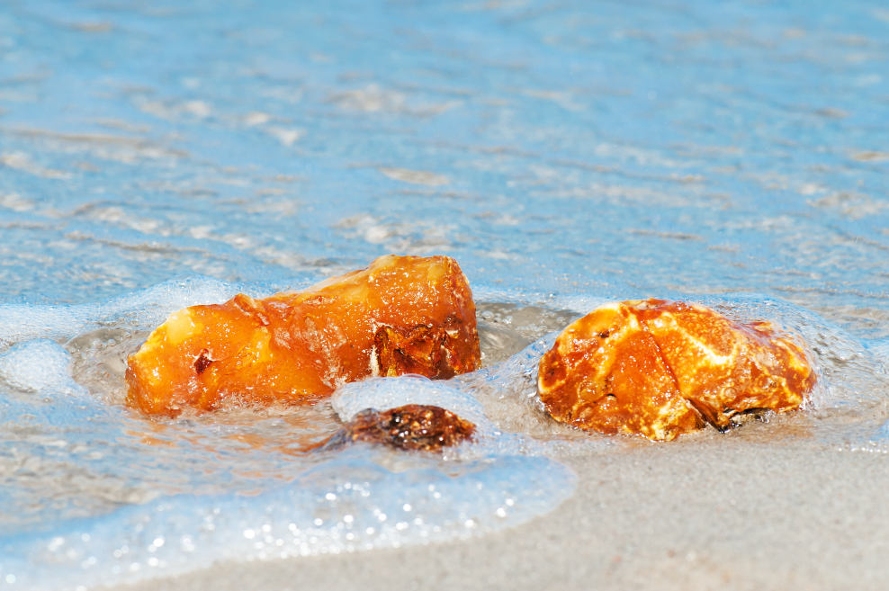
TOUR ITINERARY
Having a unique industrial deposits of amber, we created a guided tour for tourists, which includes the following:
The observation site for acquaintance with the amber mining;
«Amber pyramid» located close to production site;
Museum and Exhibition Hall of the company;
Processing of amber in the factory;
Souvenirs and collection items ;
Café with the special "Amber menu."

Slide 4
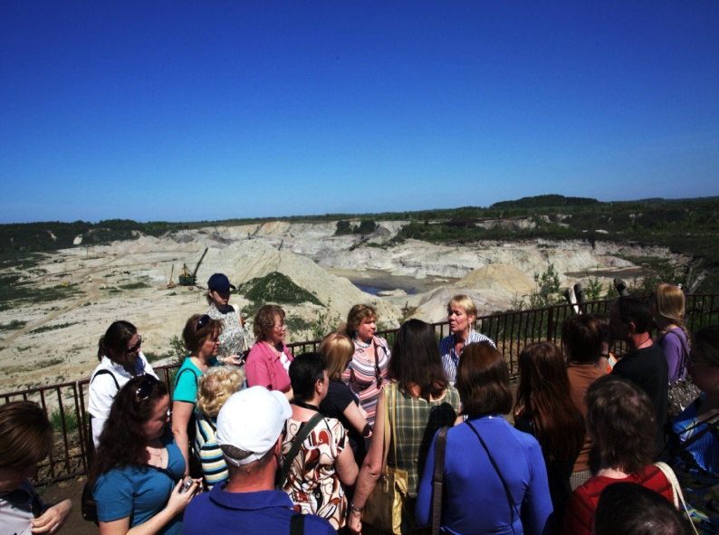
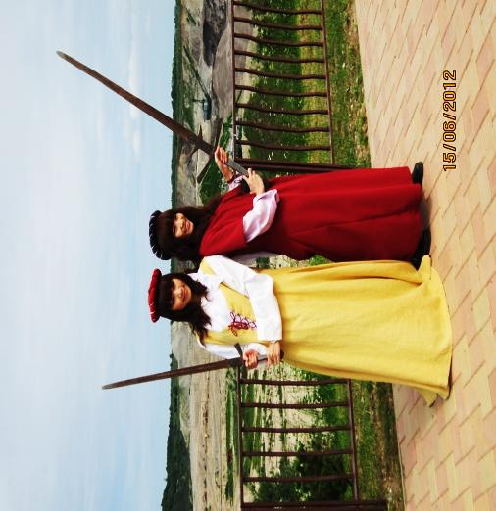
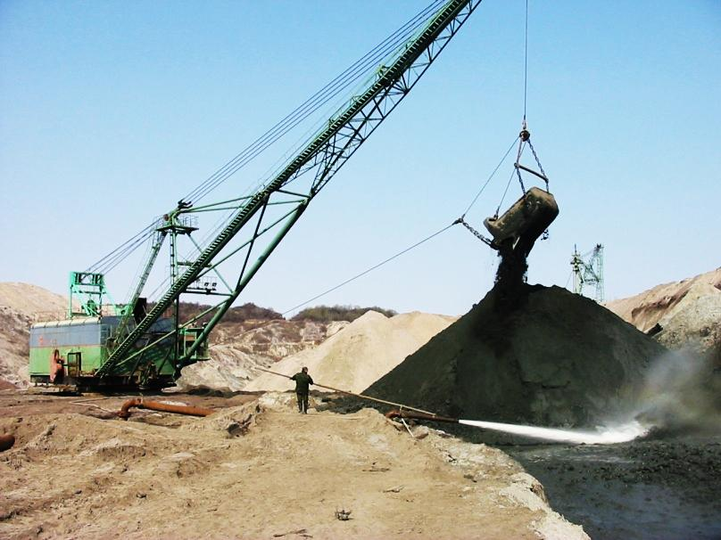
THE OBSERVATION SITE OF THE OPEN-PIT.
The observation site offers a panoramic view of the unique deposit from the height of 60 m, where the amber is industrially produced.
Tourists take part in " amber catching ", participate in spear running and in animated activities such as "Amber trials."

Slide 5
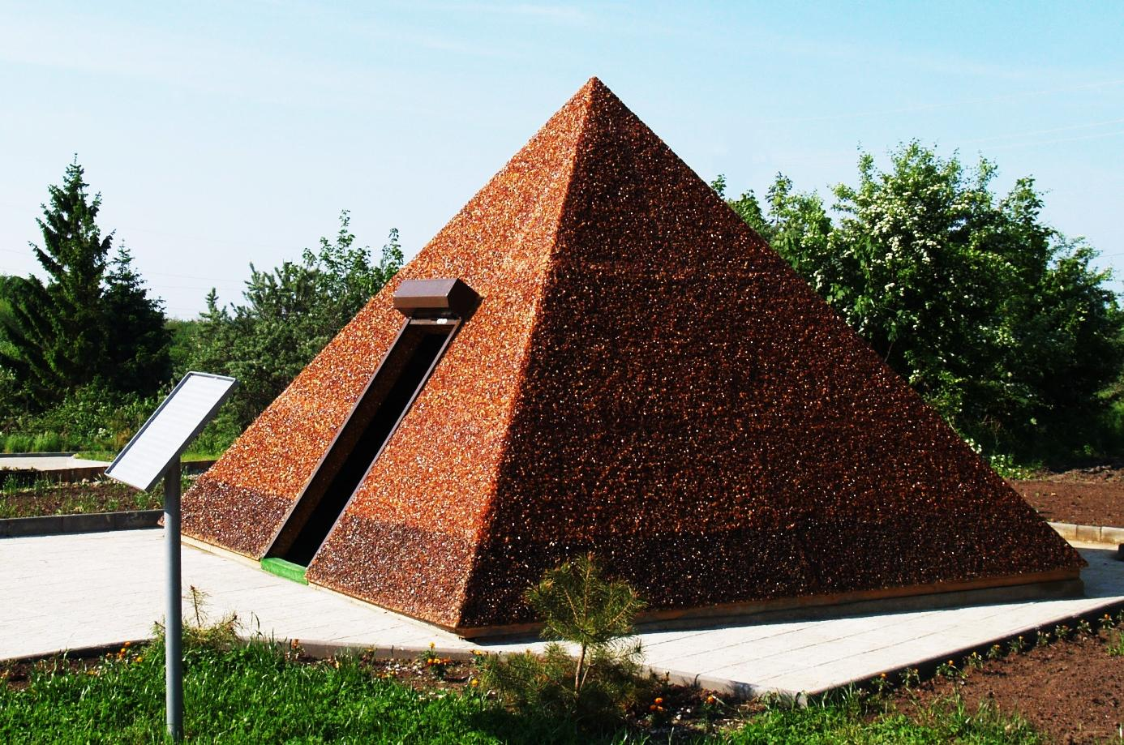
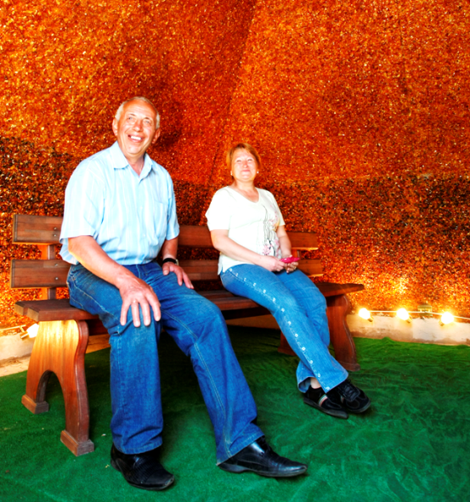
AMBER PYRAMID
In May 2012 a new tourist attraction “Amber pyramid” with the height of 3.3 m was opened.
The pyramid is built according to the principal of a "golden section".
800 kg of amber were used to build the pyramid.
About 5000 people have visited the pyramid within one month.

Slide 6
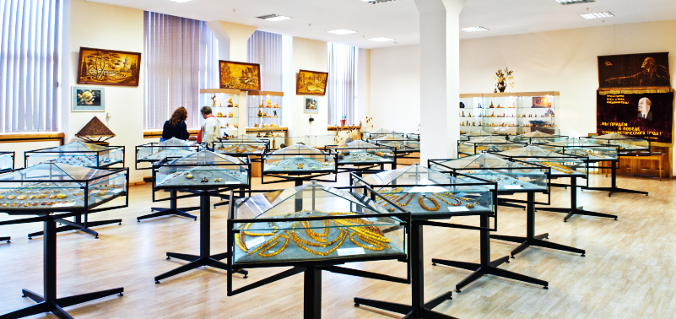
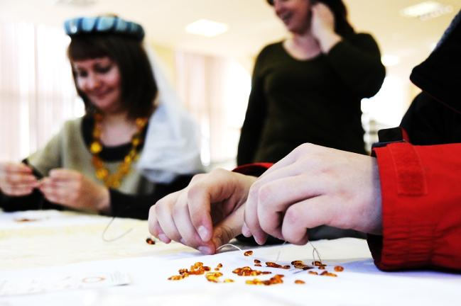
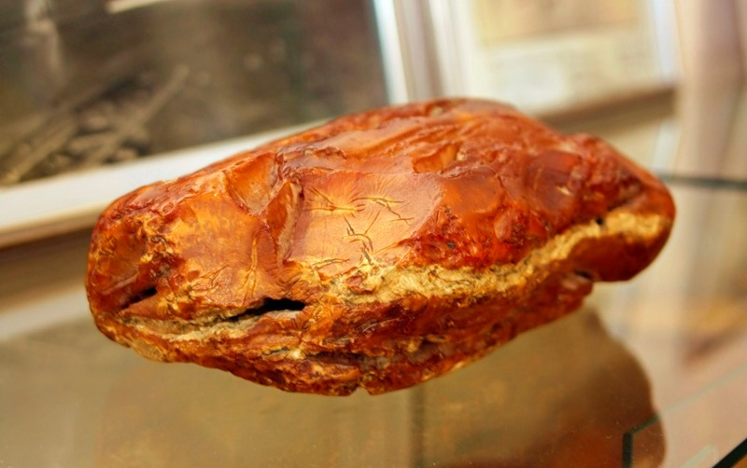
MUSEUM AND EXHIBITION HALL
The collection of unique pieces of amber some of which are up to 3 kg
Jewelry and artworks of amber stone-cutters of the factory.
History of mining and processing of amber.
The museum presents an opportunity for its visitors to make a hand-made amber souvenir by themselves and to get a diploma "Amber-maker."

Slide 7
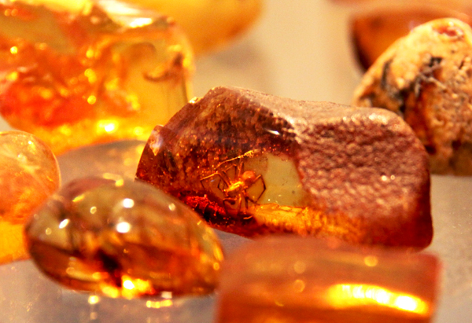
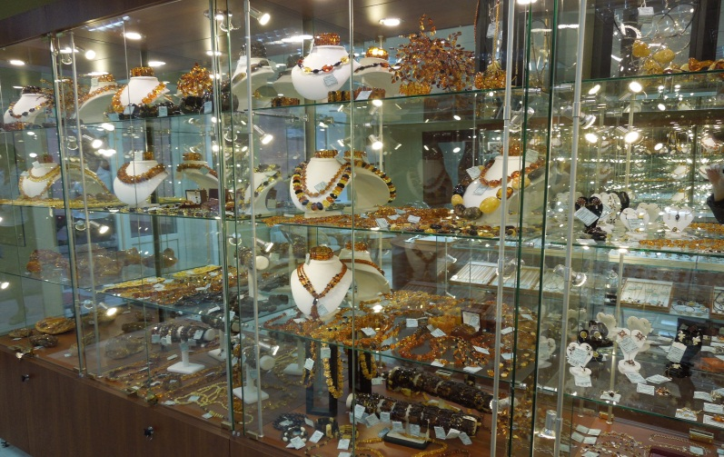
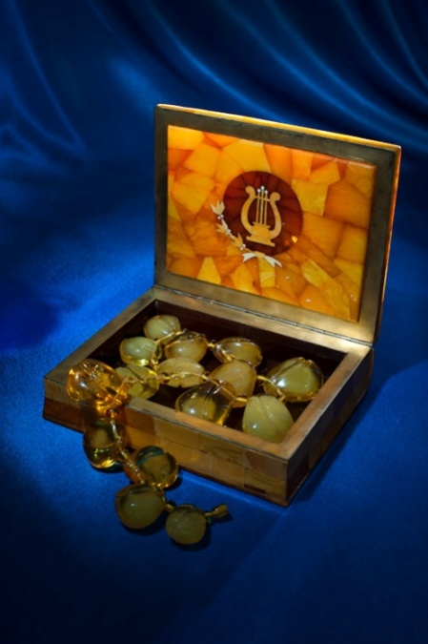
PRODUCTION OF AMBER ITEMS AND BUYING SOUVENIRS OF THE AMBER COMBINE
Acquaintance with the lines of amber processing and a full production cycle of finished goods.
Buying of souvenirs, produced at the factory and displayed in a wide range in the factory’s stores,show-room.

Slide 8
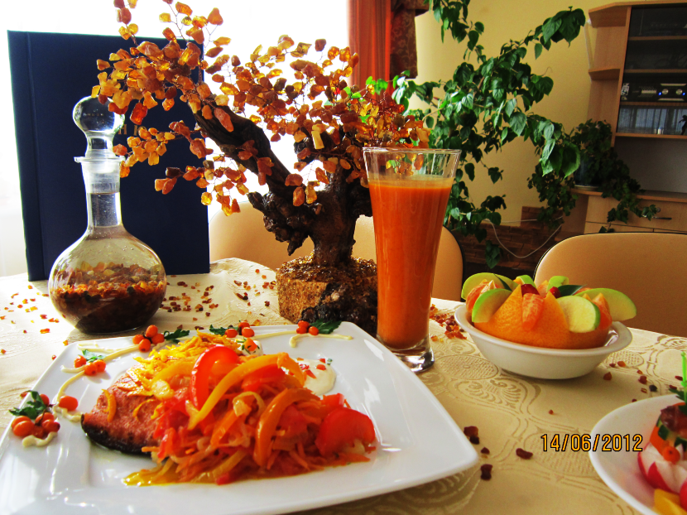
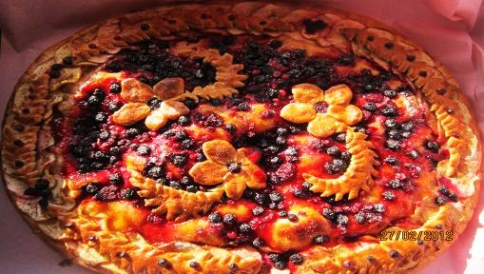
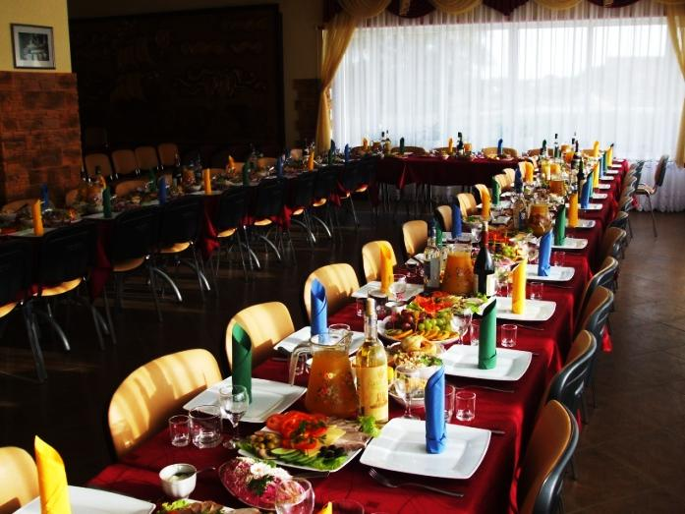
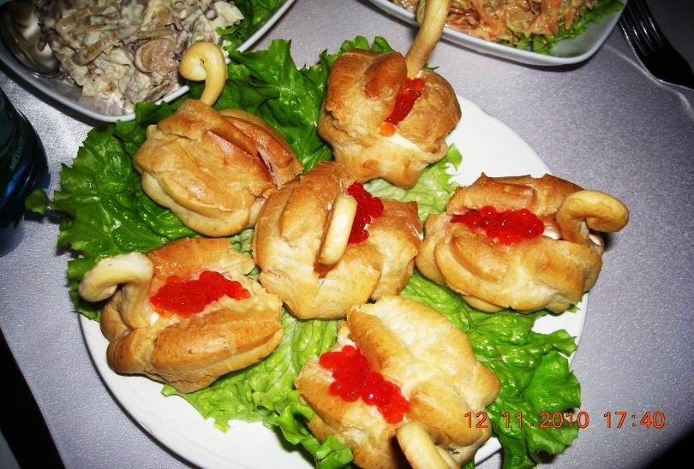
AMBER MENU
In the café "Alatyr" one can try amber dishes, cooked with the special original recipes.

Slide 9
DYNAMICS OF VISITING
Foreign tourists
Russian tourists
Visitors

Slide 10
AMBER COMBINE
AMBER FACTORY offers its tourist objects as a part of the « Baltic Amber Way».
Industrial tourism in the enterprise is not an only, but also an additional way to attract the attention to the amber,the so-called sunstone.
Visit to the only amber borrow pit in the world containing 90% of the of the
world’s deposits of the amber took its specific place among the tourist routes available in Kaliningrad region.

